Slide 1

An Overview Of Deep Learning In Medical Imaging Focusing On MRI
Presented By :
23RH1A66V9 T.Sruthi
23RH1A66W9 T.Varshitha
23RH1A66X0 T.Srivalli
Guide : Mrs.B.Vijaya Durga
Assistant Professor

Slide 2
PROBLEM STATEMENT
Medical imaging, particularly MRI, generates vast amounts of complex data that require precise interpretation for accurate diagnosis.
Traditional analysis methods often lack efficiency and accuracy, leading to misdiagnosis or delayed treatment.

Slide 3
ABSTRACT
MRI, is a powerful, non-invasive tool that provides detailed images of the body’s internal structures. It plays a crucial role in diagnosing complex conditions, including brain and soft tissue tumors.
Deep learning has revolutionized medical imaging by enhancing the accuracy and efficiency of MRI analysis, particularly in tasks like tumor detection and image enhancement.
This presentation explores advancements in deep learning techniques, their integration into MRI workflows, and their potential to address the limitations of traditional methods.

Slide 4
EXISTING SYSTEM
The existing MRI-based tumor detection system relies on manual interpretation by radiologists, supported by traditional image processing techniques.
Some existing systems use AI-based tools for tumor detection in MRI, but these are often limited to traditional machine learning algorithms or basic rule-based systems.

Slide 5
DISADVANTAGES OF EXISTING SYSTEM
Radiologists visually inspect MRI scans to identify and classify tumors, often relying on their experience and pattern recognition skills.
Human radiologists are amazing, but they face limitations:
Speed: They can get tired analyzing countless images.
Accuracy: Sometimes accuracy is not detected properly.

Slide 6
PROPOSED SYSTEM
CNNs are popular because they preserve spatial relationships in images.In radiology, spatial context matters (e.g., bone-muscle edges, tumor boundaries).
Layers in a CNN:
Convolutional Layers: Detect features (edges, textures).
Rectified Linear Unit (ReLU) Layers: Introduce non-linearity.
Pooling Layers: Downsample and retain important features.
Fully Connected Layer: Assign class scores or probabilities.

Slide 7
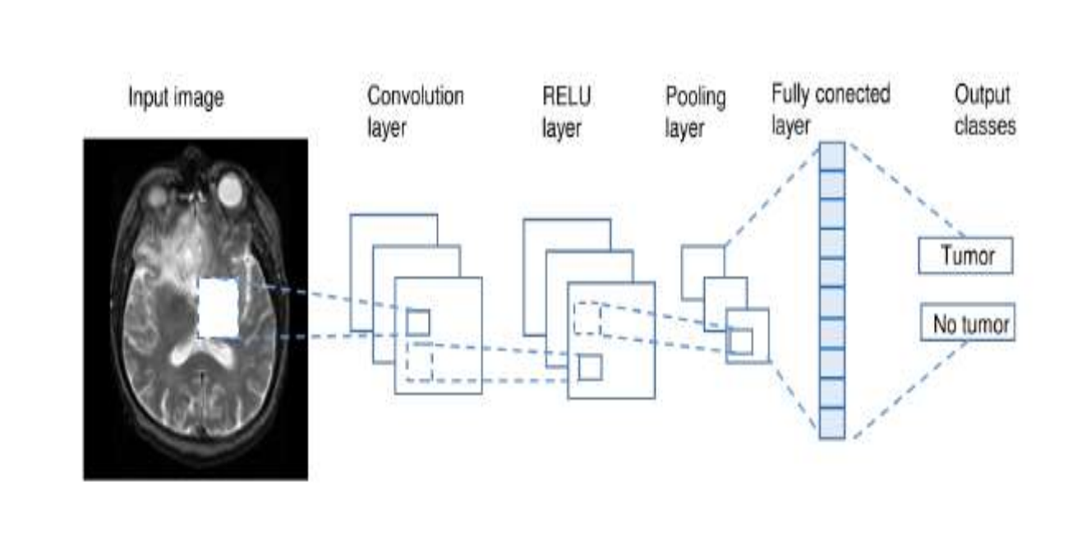
SYSTEM ARCHITECTURE

Slide 8
ADVANTAGES
Deep learning can revolutionize medicine by assisting in drug discovery, treatment planning, and diagnostics.Imagine algorithms helping doctors make better decisions faster.
Deep learning algorithms can analyze images swiftly and tirelessly.They learn from examples and spot patterns that humans might miss.
Accurate analysis means better diagnoses and treatment plans.Algorithms don’t get fatigued or distracted.

Slide 9
SYSTEM REQUIREMENTS
SOFTWARE REQUIREMENTS:
OS : Windows
Python IDE : Python 3.7.0
HARDWARE REQUIREMENTS:
RAM : 4GB and Higher
Processor : Intel i3 and above
Hard Disk : 500GB: Minimum

Slide 10
MODULE DESCRIPTION
Upload MRI image : Using this module, we will upload MRI images, and then the application will automatically read and convert them into grayscale format.
Otsu Thresholding : Using this module, we will apply OSTU thresholding technique on each image to extract features.
Generate Train & Test Model : Using this module, we will build array of pixels with all images features and then split dataset into train and test model to calculate accuracy using test images by applying train model on it.

Slide 11
MODULE DESCRIPTION
Generate Deep Learning CNN Model : Using this module will input train and test data to auto stack CNN model to build training classifier.
Get DriveHQ Images : Using this module we will read test image from DriveHQ website and then application will apply CNN classifier model on that test image to predict whether image contains tumour disease or not.

Slide 12
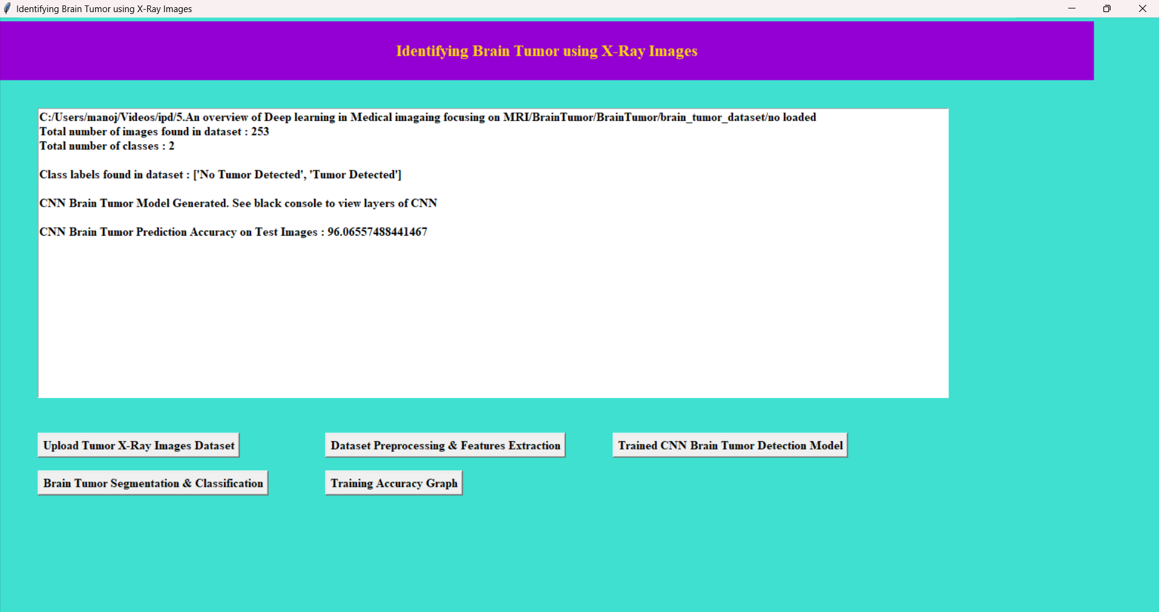
OUTPUT SCREENS

Slide 13
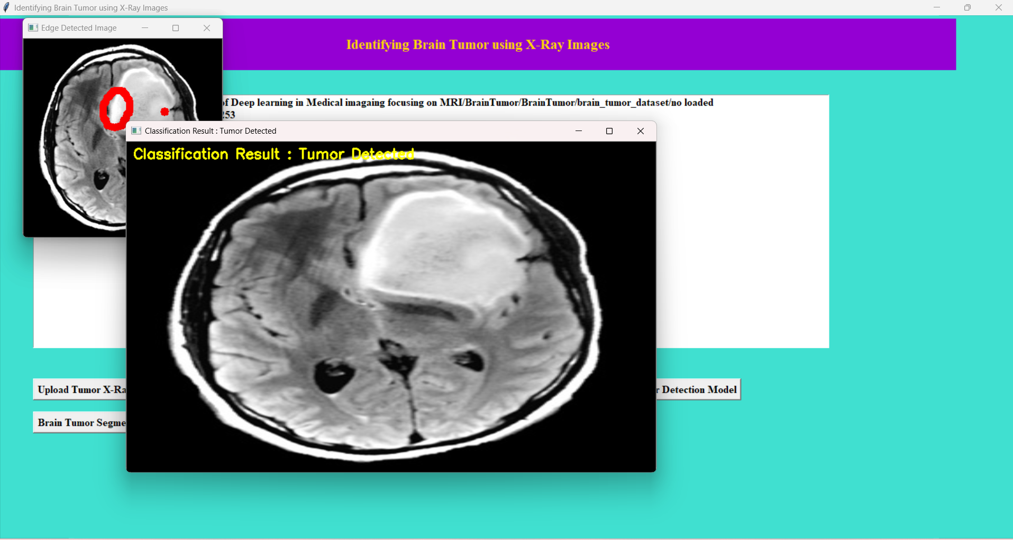

Slide 14
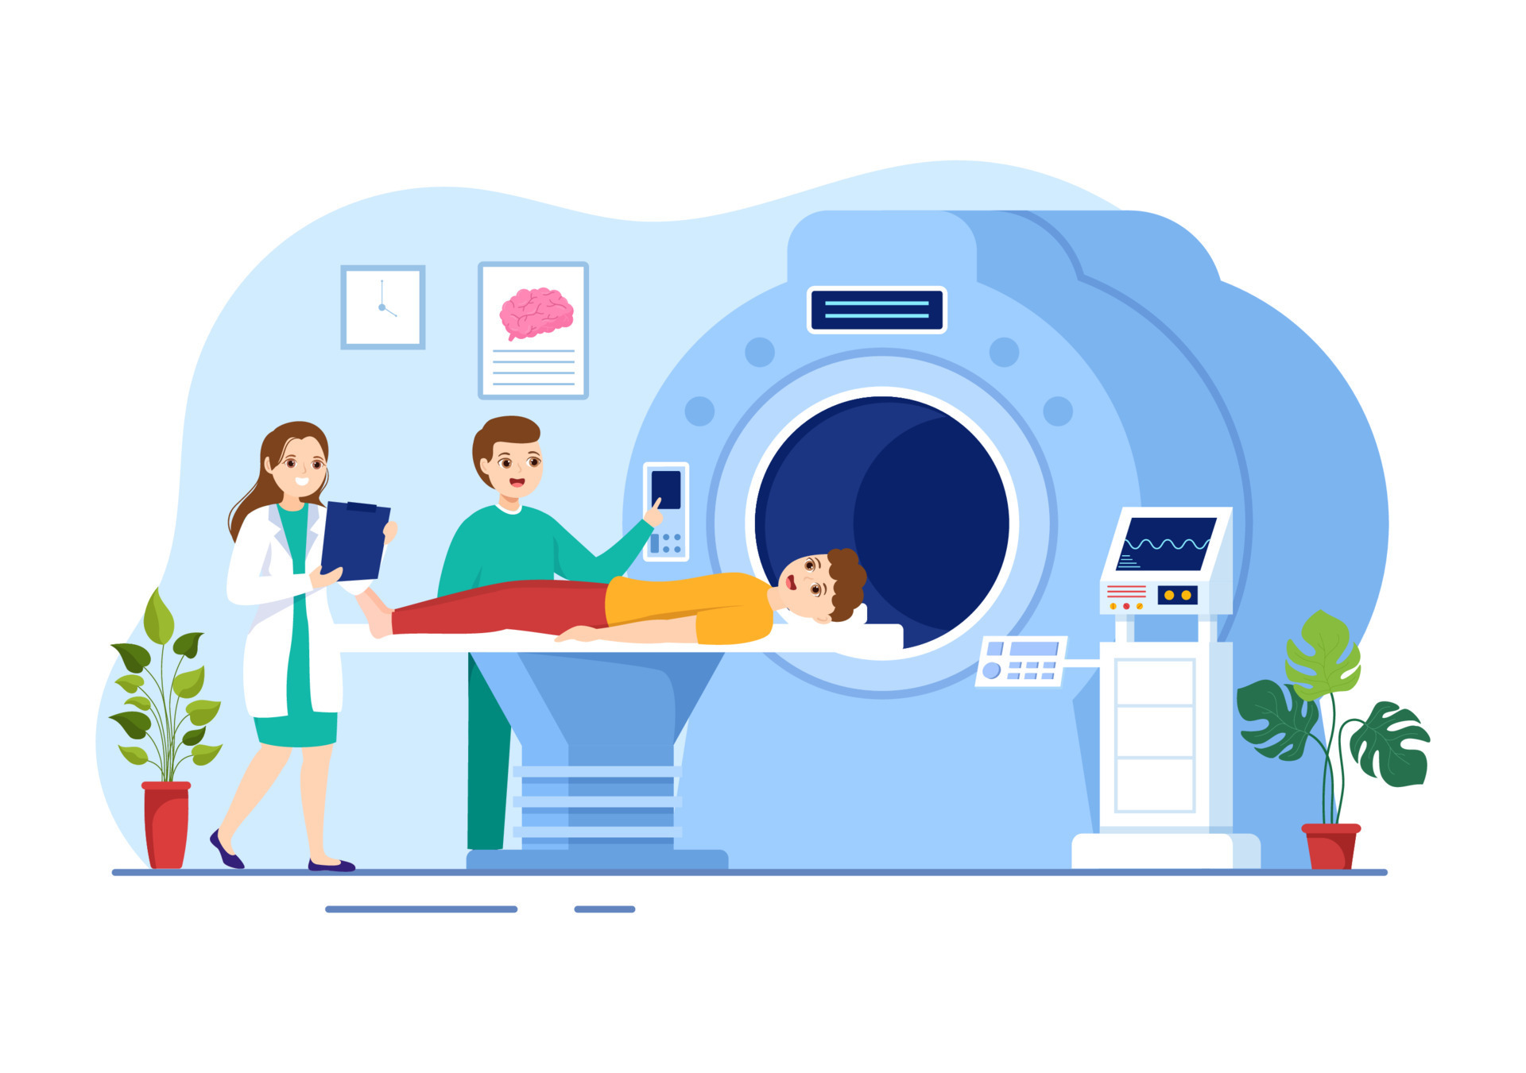
CONCLUSION
Deep learning improves MRI accuracy and efficiency, benefiting clinical decisions and patient outcomes.
AI-driven diagnostic tools are increasingly essential in healthcare workflows.
Ongoing research suggests deep learning will revolutionize MRI imaging.

Slide 15
FUTURE SCOPE
Faster MRI Scans: By using deep learning, MRI machines could produce high-quality images with less data, allowing quicker scans. This could make MRI more accessible, especially for patients who struggle to stay still for long periods.
Advancements in 3D Imaging: Future deep learning models could improve 3D imaging in MRI, giving doctors a better look at organs or tissues from different angles, which helps in detailed diagnosis and treatment planning.
Improving Accuracy: With continuous learning, deep learning models will likely become better at distinguishing between normal and abnormal tissues, which can help reduce diagnostic errors.

Slide 16
THANK YOU

